Slide 1
SCB Meeting
October 6, 2016

Slide 2
Official membership
$5 fee
Voting privilege, priority for field trip spots
We’ll be passing around a membership sign-up sheet
  Please list your name and email address
  See any Exec (Brigitte, Hillary or Kristen) after the meeting to pay

Slide 3


Co-chair needed!
Still need one co-chair for the Fundraising Committee
Will be elected by subcommittee after the meeting (ie you have some time to think about it!)
Not sure? Talk to the Exec! We love questions.

Slide 4
“Creature” feature:
Blanding’s Turtle (Emydoidea blandingii)
Physical Features:
  Dark domed shell
  Distinctive bright yellow chin and throat
Habitat:
  Shallow wetlands with clean water and mucky bottoms
  Make the largest overland movement of any turtle in ON – move between winter hibernation site / nesting site to summer habitat
  Females do not mature until 14 years old, and can live to be over 75 years old!

Slide 5
“Creature” feature:
Blanding’s Turtle (Emydoidea blandingii)
Listed as ’Threatened’ in ON and federally
Threatened by habitat loss, road traffic, and illegal poaching
  Shoreline development destroys nesting sites
  Vehicles are a threat to migrating turtles
  Captured for pet and food trade
There are recovery strategies and activities underway to protect the Blanding’s Turtle
Kawartha Turtle Trauma Centre
  rehabilitates injured turtles
  tracks them to monitor populations

Slide 6
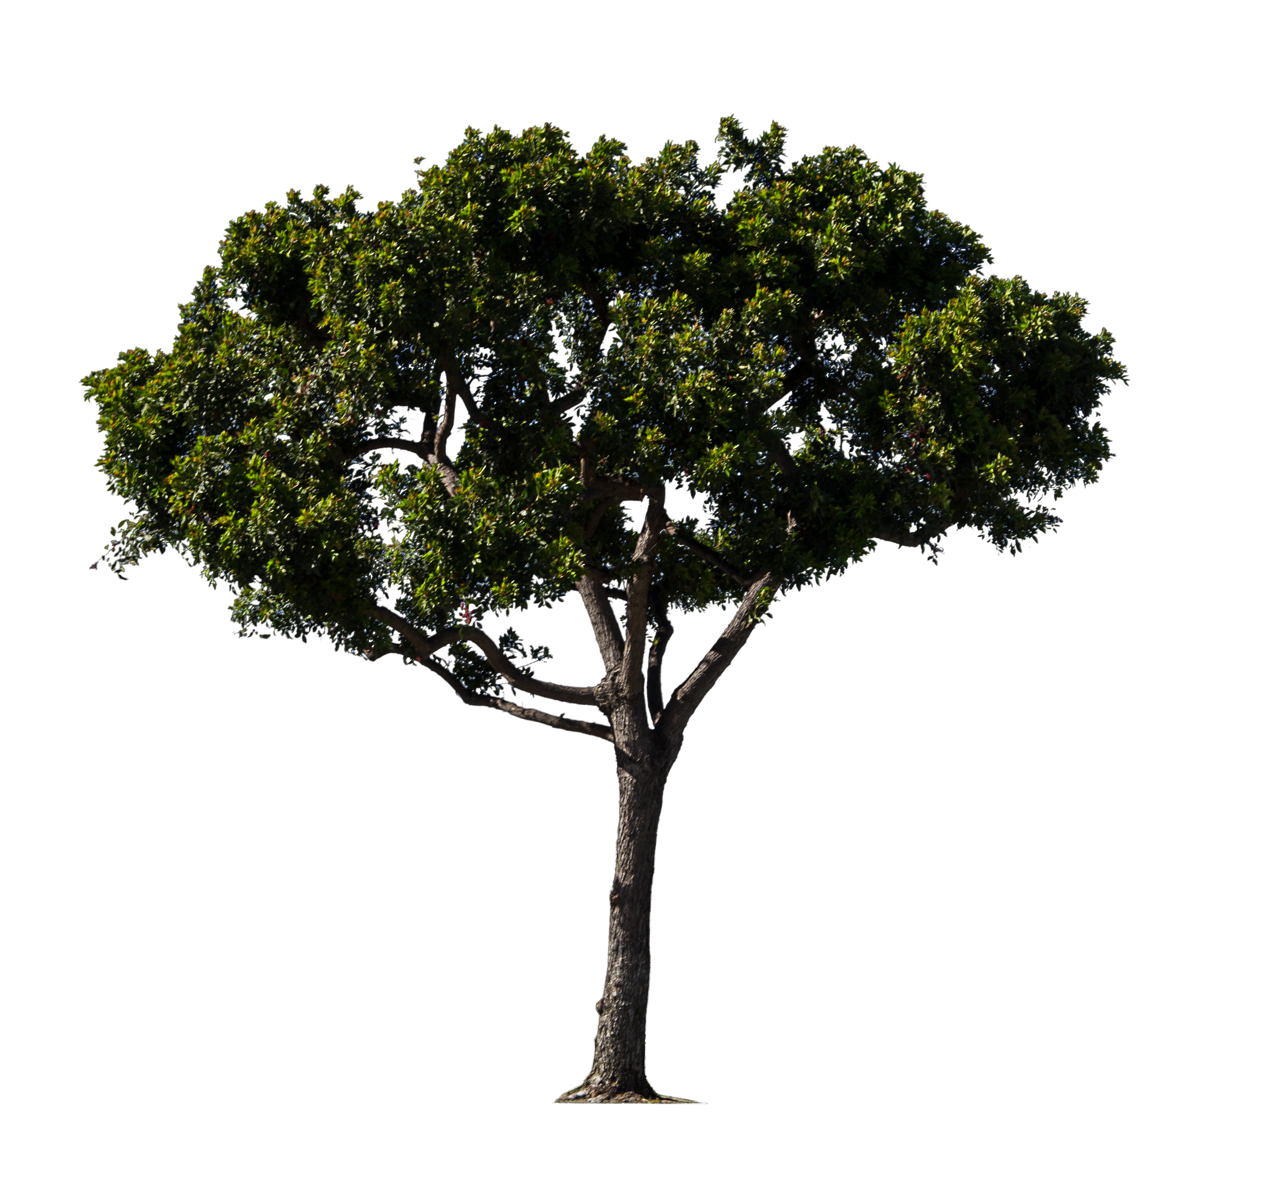
Committee Updates
S/I
  OCTOBER 17 – Great Canadian Shoreline Cleanup
  October 29 – Potential date for Garden clean-up and seed collection
  November 12 @ 1pm – Potential date for CRCA hike
  Farmer’s Market seed bombs – progress?
Education
  October 12 - Fish and Frogs presentations
  Meeting with Dan?
Fundraising
  Voting time!
  October 12 - Bake Sale!
    Need treat donations and volunteers to manage table
    Little Brown Bat info sheets?
  E-mailing photo contest prize donors?
  Potential date for social event?

Slide 7
T-Shirts For sale!
12$

