Slide 1
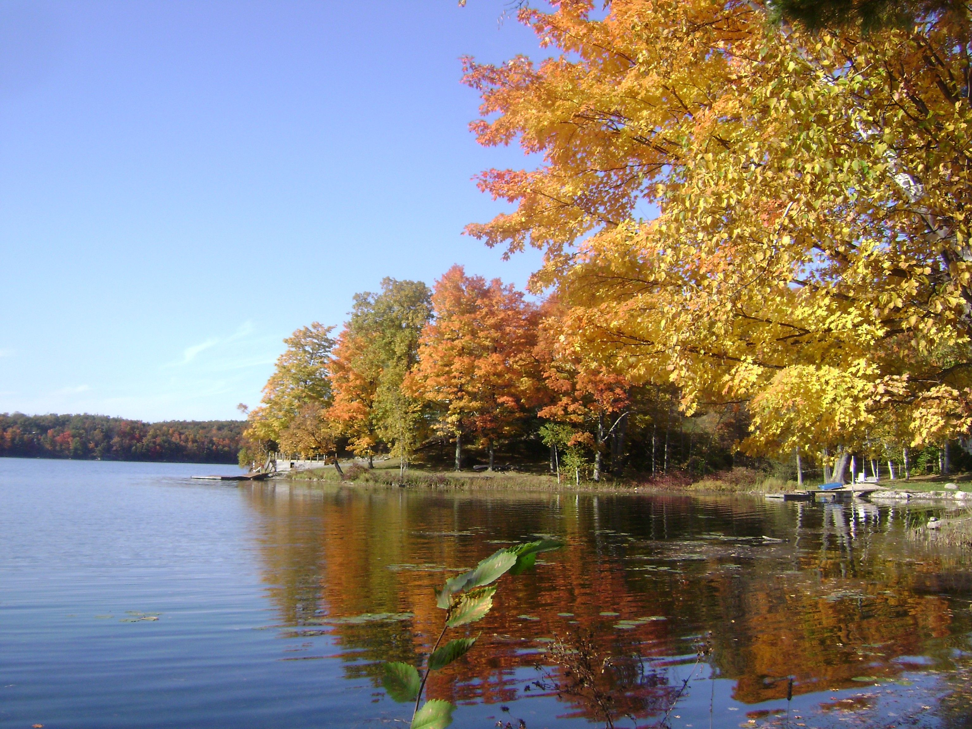
SCB Meeting
September 22, 2016
HAPPY FIRST DAY OF FALL!

Slide 2

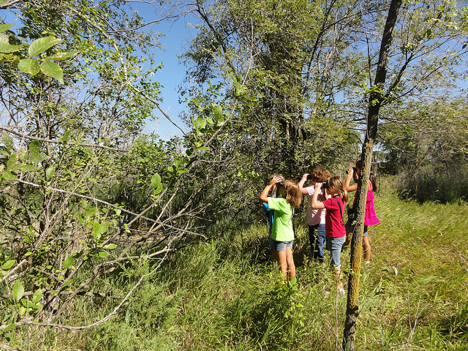

Official membership
$5 fee
Voting privilege, priority for field trip spots
We’ll be passing around a membership sign-up sheet
  Please list your name and email address
  See any Exec (Brigitte, Hillary or Kristen) after the meeting to pay

Slide 3


Co-chairs needed!
Still need two co-chairs for the Fundraising Committee
Will be elected by subcommittee after the meeting (ie you have some time to think about it!)
Not sure? Talk to the Exec! We love questions.

Slide 4
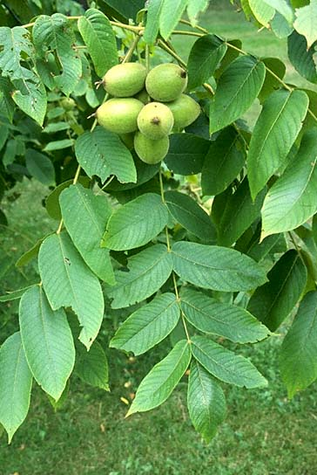
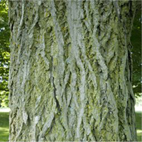
“Creature” feature:
Butternut Tree (Juglans cinerea)
Member of the walnut family
Flowers April to June
Nut is lemon-like
  Starts producing nuts at ~20yo
Shade and competition intolerant
Lives up to 75yo
Historical uses:
  Boiled bark = Yellow Dye
  Medicinal → bark was boiled during the American Revolution in an attempt to prevent dysentery and smallpox
  Lumber, woodcarving, furniture

Slide 5
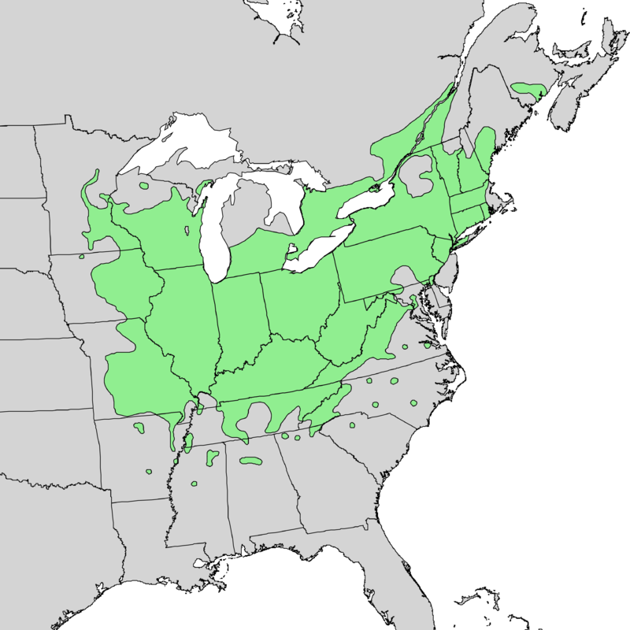
“Creature” feature:
Butternut Tree (Juglans cinerea)
“Endangered” since 2005
Cultivated for its
Threatened by:
  Butternut Canker
    Caused by Sirococcus clavigignenti-juglandacearum
    Fungus spread by many vectors
    Diseased trees die within several years
  Hybridization with non-native walnuts*
  *Some hybrids are being intentionally produced because they are typically resistant to Butternut Canker – ex. Cross with the Japanese Walnut (aka the baurtnut)

Slide 6
What conservation initiative are you passionate about?

Slide 7
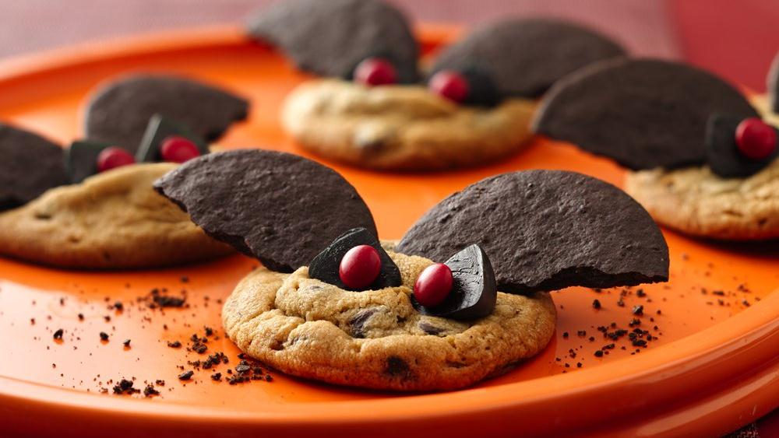
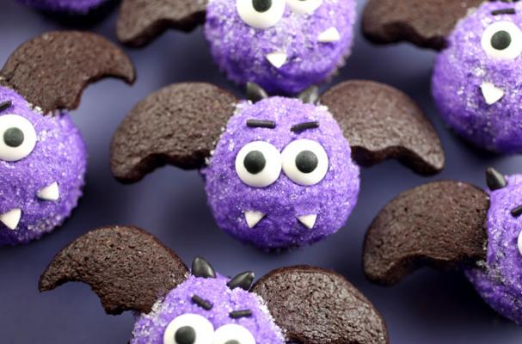
Updates and Upcoming!
T-shirts on sale during weeks 4 & 5
Check this out: State of Ontario’s Biodiversity – 2010 Report: http://www.ontariobiodiversitysummit.ca/html/state_ont_report.html
S/I
  Shoreline Cleanup – this weekend or next!
  Garden clean-up – think of dates!
  Other updates?
Education
  Contacting teachers
  New Facebook group!
Fundraising
  Voting time!
  OCTOBER 12 – Bat-Themed Bake Sale

