Slide 1
SCB Meeting
September 29, 2016

Slide 2
Official membership
$5 fee
Voting privilege, priority for field trip spots
We’ll be passing around a membership sign-up sheet
  Please list your name and email address
  See any Exec (Brigitte, Hillary or Kristen) after the meeting to pay
  Would you like to do a membership Tilt?

Slide 3


Co-chairs needed!
Still need one co-chair for the Fundraising Committee
Will be elected by subcommittee after the meeting (ie you have some time to think about it!)
Not sure? Talk to the Exec! We love questions.

Slide 4
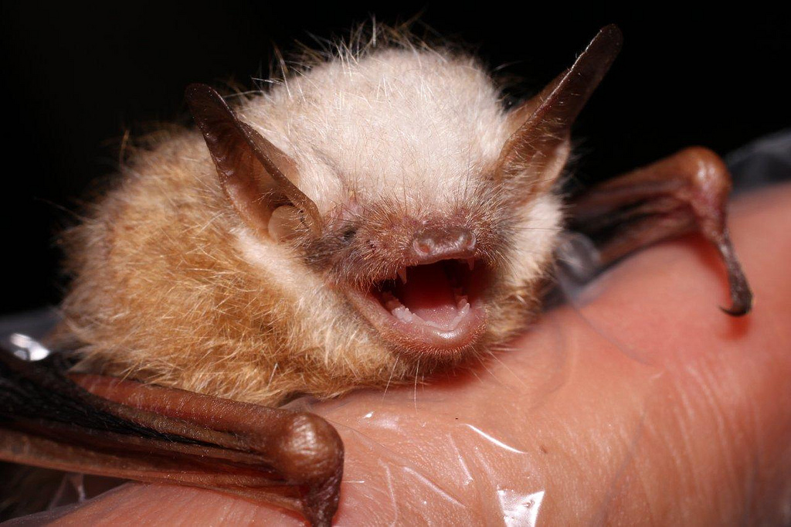
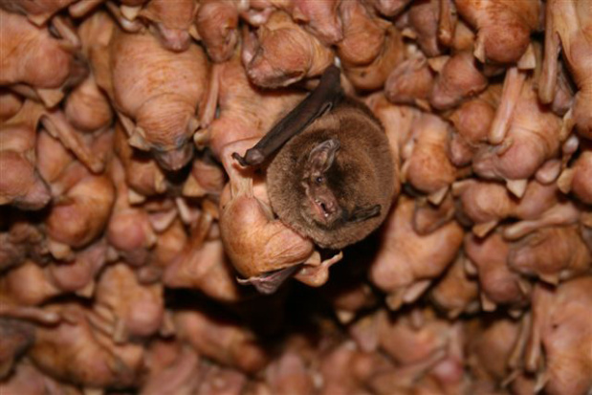
“Creature” feature:
Tri-Colored Bat (Perimyotis subflavus)
Physical Features:
  Small bat
  Pale brown
  Weighs as much as a toonie (7gm)
  Has a wingspan of 23cm
  Muzzle, ears and forearms are orange-red
Named for the hair on its back! (Black, yellow, and brown)
Habitat:
  Form maternal colonies in old forests
  Forage over water
  Overwinter in caves or underground

Slide 5
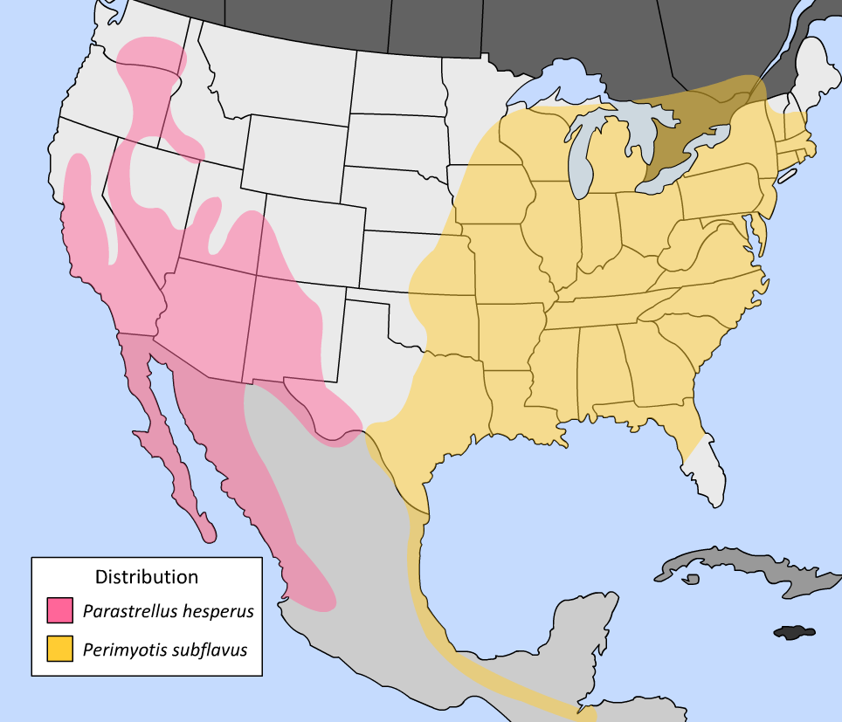
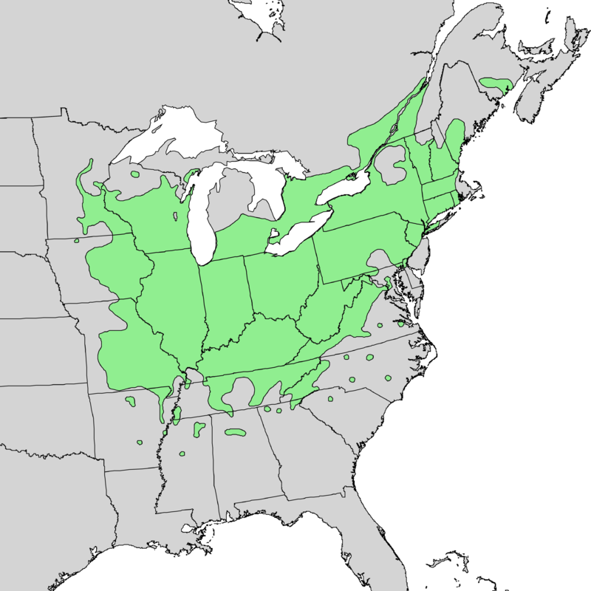
“Creature” feature:
Tri-Colored Bat (Perimyotis subflavus)
“Endangered” since 2016
Threatened by white nose syndrome
  Fungus brought from Europe
  Grows in cold, humid environments (ex. Caves)
  Disrupts hibernation
  May affect the wing membrane and water loss
Has destroyed many populations (lost >90% of individuals)

Slide 6
What conservation initiative are you passionate about?

Slide 7
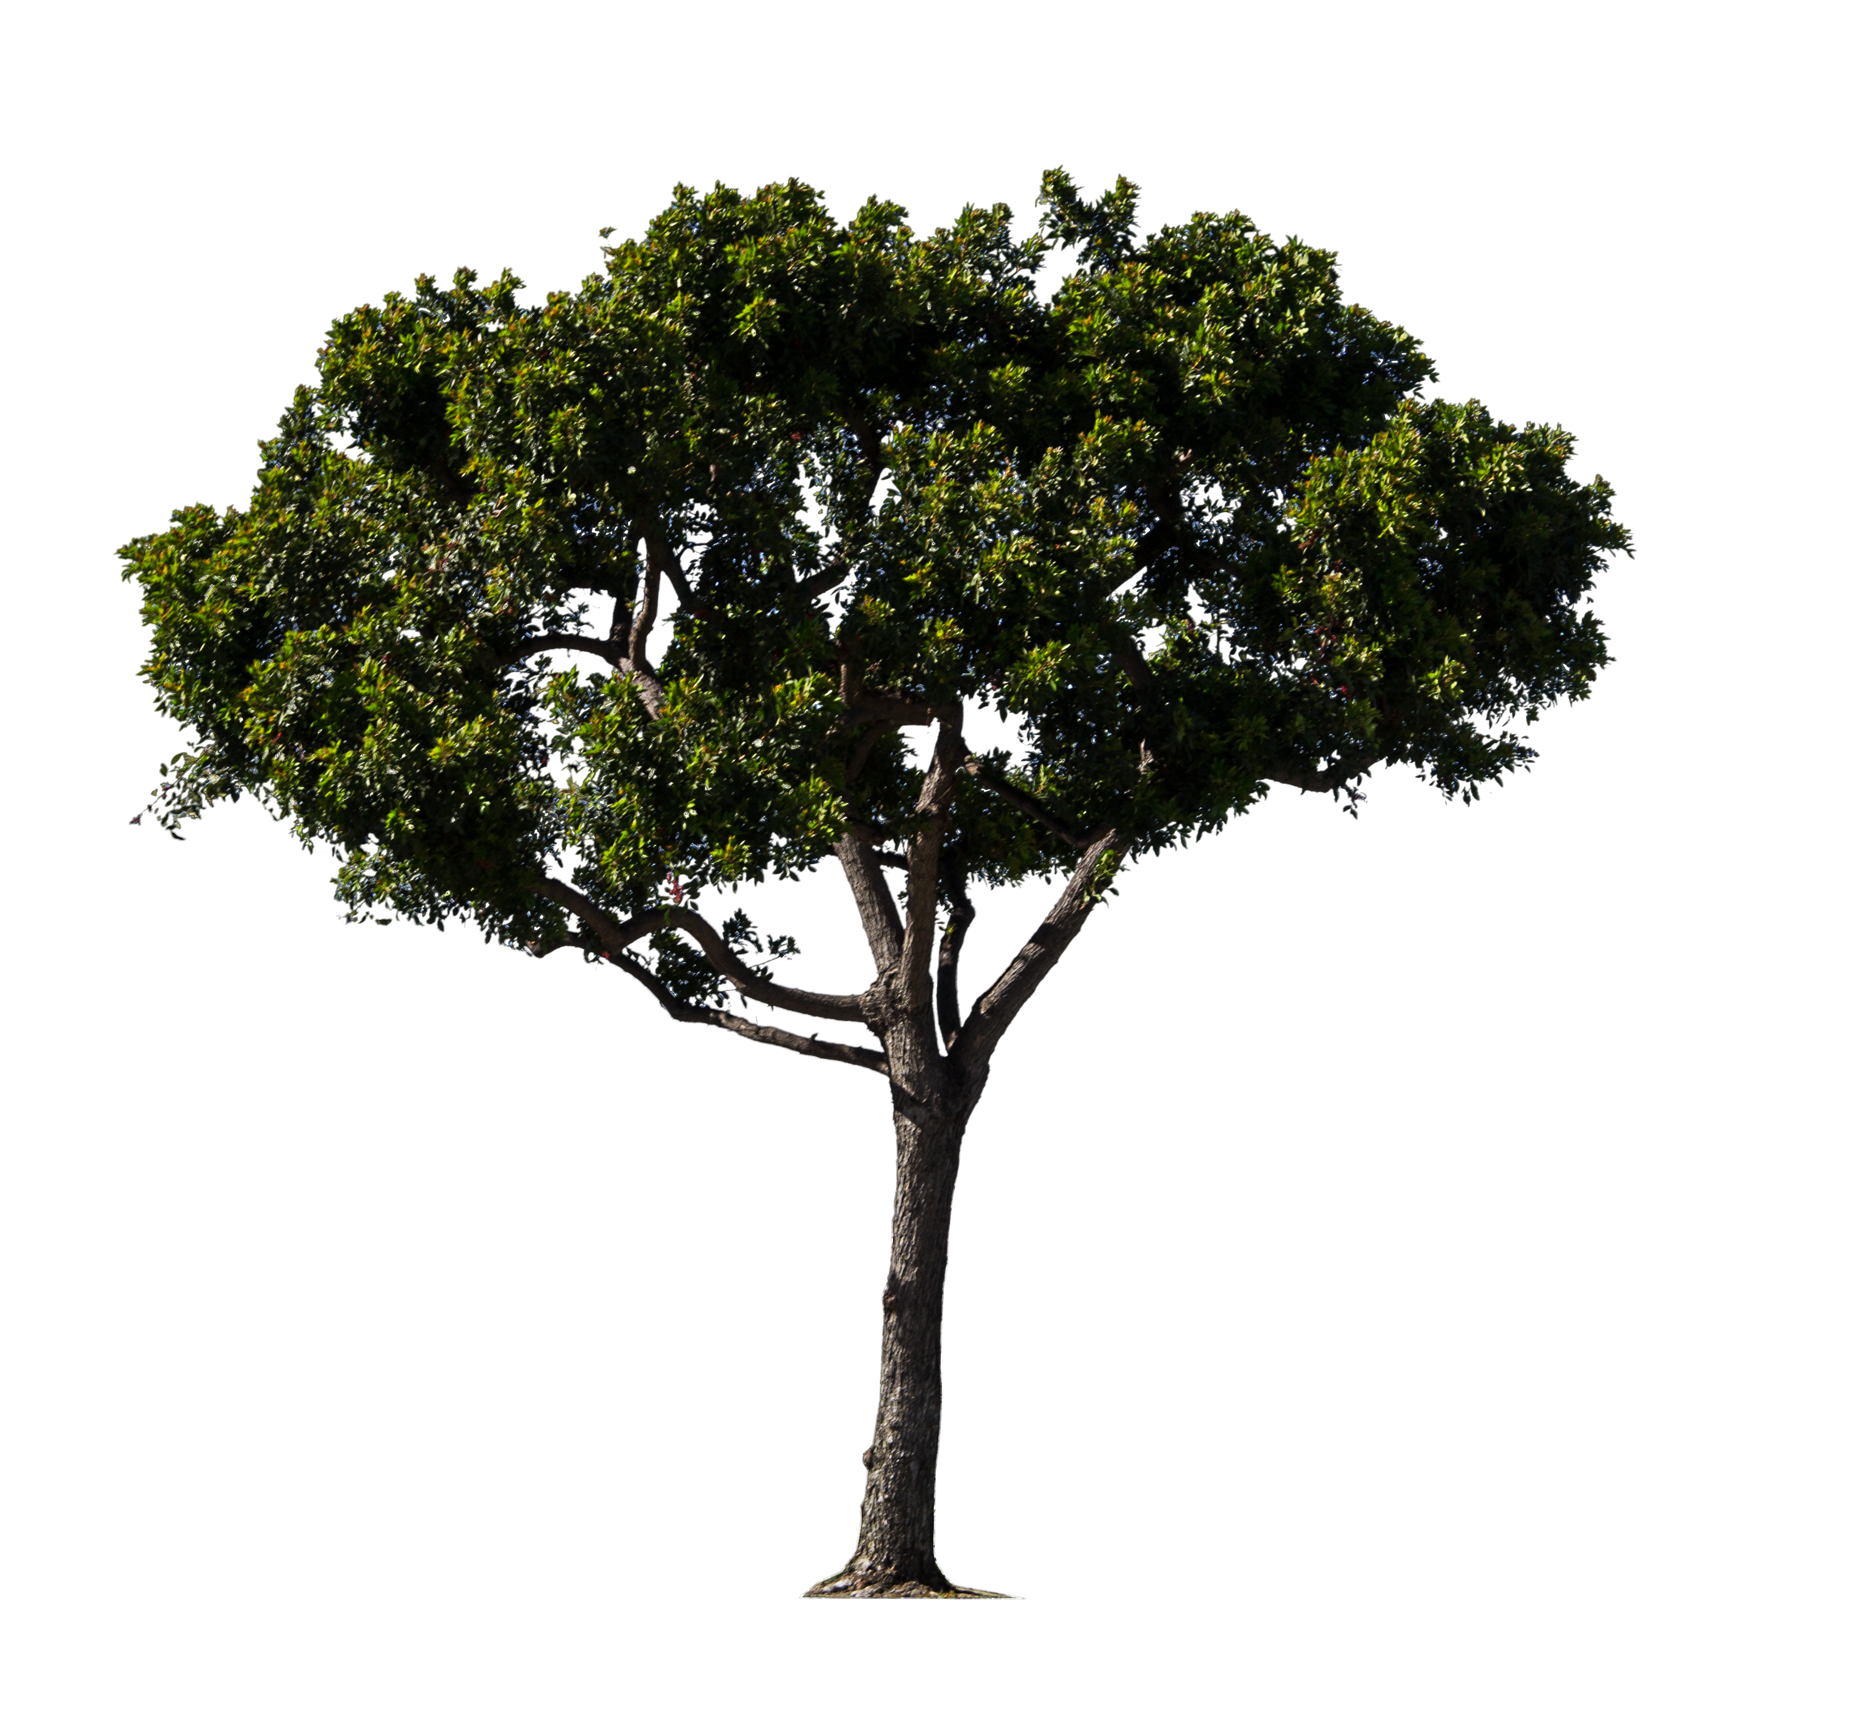
Committee Updates
T-shirts on sale next week! ($12)
S/I
  OCTOBER 17 – Great Canadian Shoreline Cleanup
  Garden clean-up – find a date next week!
  Tree planting at Lemoine Point? (October 1st)
Education
  Interested teachers?
  Meeting with Dan?
Fundraising
  Voting time!
  Bake Sale posters and Facebook event!
  Doodle poll for baking/sales?
  E-mailing photo contest prize donors?

