Slide 1
Society for Conservation
Biology
General Meeting
January 26, 2017

Slide 2
Committee Updates
Sustainability/Issues
  NCC Seminar Feb 1 @5:30, Dunning 14
Education
  Schoolyard Naturalization Feb 1 @2PM
Fundraising
  Photo Contest submissions due Feb 10
  Silent Auction set-up Feb 12
  Silent Auction Feb 13-17

Slide 3
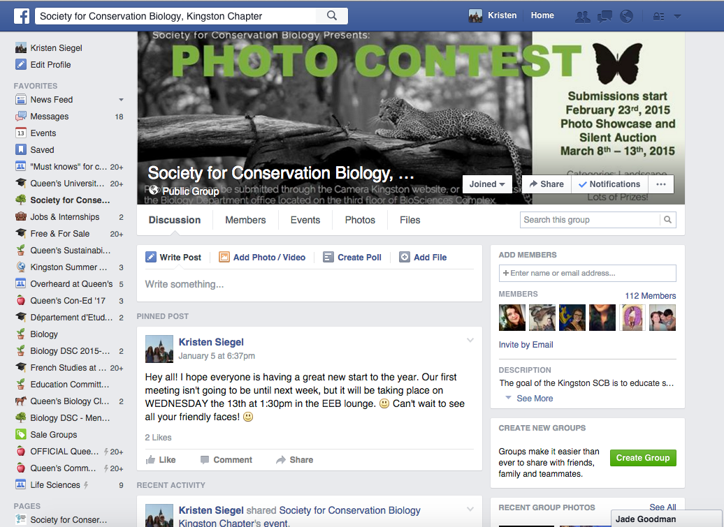
Facebook!
Public Page (major updates and events):
https://www.facebook.com/scbkingston/
Our Group (event updates, polls, meeting minutes): https://www.facebook.com/groups/157534784342507/

Slide 4
Upcoming events!
Photo Contest
  Submission period Jan 23-Feb 10
  Silent Auction Feb 13 – Feb 17
Nature Conservancy of Canada seminar
  Wed., Feb 1
  Dunning 14 @ 5:30
St. Patrick’s Day Cleanup
Science Rendezvous 2017
  Sat., May 13
  K-Rock Centre, 10:00-3:30
TBA
  Fish & Frogs Forever programming
  Nature Walk

Slide 5
End-of-meeting Activities
Posters (Zoe, Betty, Kristen)
Garden Dimensions (Georgie and Ashley)

